Slide 1

$$N=total number of points$$
$$n_{p}=\min{}number of points per calculation period$$
$$P_{n}=period$$
$$s=counter$$
$$m=period counter$$
$$r_{m}=start of the triggering rule break$$
$$f_{n}=freeze point$$
$$b_{n}=part (break) point$$
$$e_{n}=exculed point$$
are there any very extreme points? (5sd away from mean)? Yes – exclude. e_n
f_n = min(n_p,N)
b_n =

Slide 2
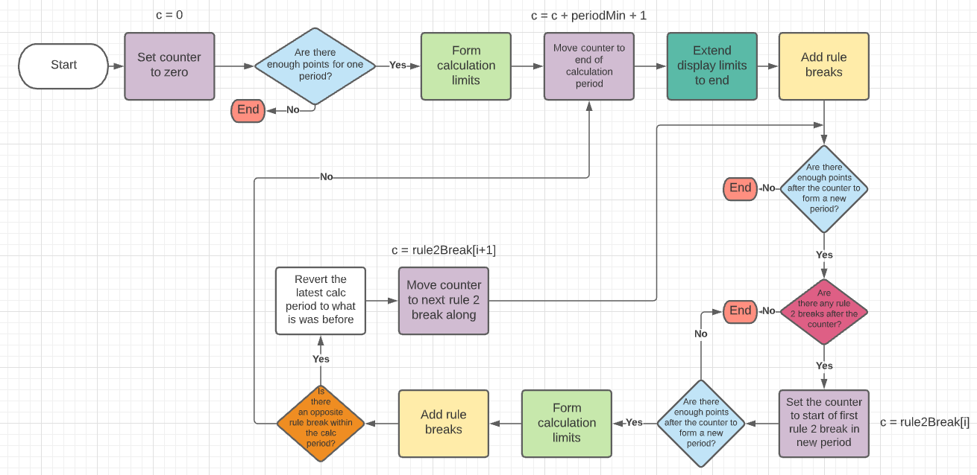
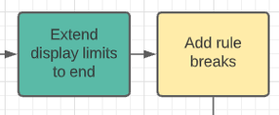
Remove extremes
enough_data_for_new_period()
form_calculation_limits()
form_display_limits()
add_rule_breaks()
Counter = counter + 1
If at least 8 points are rule 2 break after counter ELSE
rule2_break_scan() - with respect to which limits?
Set to next rule 2 break from list
identify_opposite_break()
Candidate limits
Extend display limits
Remove extremes
Construct list of rule 2 breaks

